Slide 1

ASSEMBLED DEEP LEARNING MODEL FOR STOCK PRICE PREDICTION
Name: Sotaro Suzuki
Supervisor name: Szymkowski Maciej
Notes:
As you can see on the screen, our topic today is......

Slide 2

Table of contents
Introduction
The application of deep learning
Why is stock price prediction difficult?
Methods of stock price prediction
Related work
Proposed method
Algorithm used
Data collection and preparation
Evaluation Indicator
Results
Modification
Notes:
Here is...

Slide 3
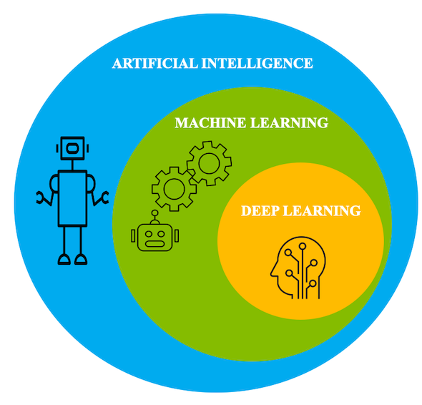
Introduction
What is deep learning?
Deep learning is a subset of machine learning, which is a subset of artificial intelligence.
Artificial intelligence is a general term that refers to techniques that enable computers to mimic human behavior.
Machine learning represents a set of algorithms trained on data that make all of this possible. Deep learning is just a type of machine learning, inspired by the structure of the human brain.
Notes:
As we can see the picture

Slide 4
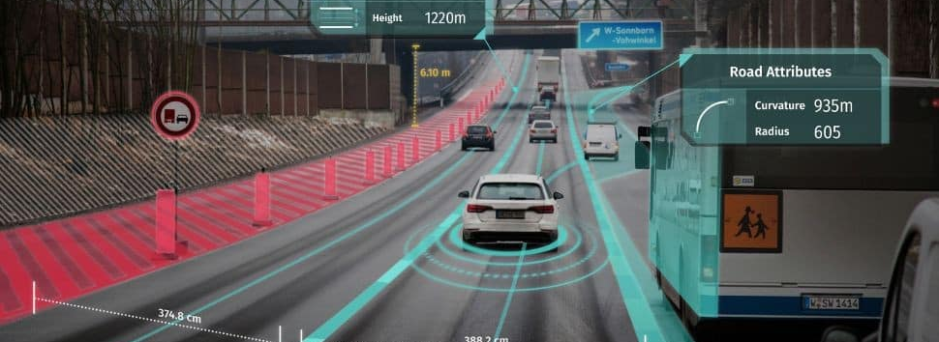
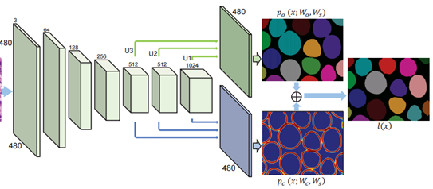

The application of deep learning
Image processing
Facial recognition system
Self-driving
Detection of cancer cells
natural language processing(NLP)
Search engine
Chatbot
Article recommendation
Speech recognition
Smart speaker
Notes:
In recent years, there have been significant developments in deep learning.

Slide 5
Why is stock price prediction difficult?
Random work theory / efficient market hypothesis
The theory states that stock prices cannot be predicted because changes in stock prices are random. The theory presupposes that financial markets are efficient.
That is, all publicly available information is incorporated in the stock’s current price due to market participants being rational profit maximizers. If any anomaly existed, it would quickly be exploited and removed, leading to a more efficient state.
The rejection of the random walk theory
In many theses, it was observed that a better algorithm could improve prediction accuracy.

Slide 6
Methods of stock price prediction
 | Quantitive investment | Trading algorithm | High-frequency-Trading(HFT) | Robo-advisors | AI trading bot
Origin | 1980~ | 1990~ | 2000~ | 2000~ | 2010~
Role/job | Fund manager | Trader | Arbitrage trading | Fund manager | Fund manager
Automation | Buy or Sell Decision | Buy or Sell Order | Buy or Sell Order | Buy or Sell Decision | Buy or Sell Decision
Objective | Increasing investment income | Reduction of decision cost | Increasing investment income | Increasing investment income | Increasing investment income
logic | Financial engineering | Technical analysis | Technical analysis | Financial engineering | Artificial intelligence
competition | Idea from big date | Low cost | Speed | Easiness | Bigdata engineering

Slide 7
Related Work
Machine Learning
Deep Learning
RNN
LSTM (K-means LSTM, attention-based LSTM, PCA LSTM)
GRU
Transformer
SVM
XGBoost
LightGBM
Notes:
The state of the art methods for stock price prediction
While, there are few papars that proposed the hybrid model of structured data such as historical data and unstructured data such as text data in daily news

Slide 8
Proposed method/Key challenge
Hybrid model of deep learning model
Deep learning algorithm
BERT
LSTM
Assemble leaning algorithm
LightGBM
Notes:
Thus, I propose a method of...
This is the hybrid….

Slide 9
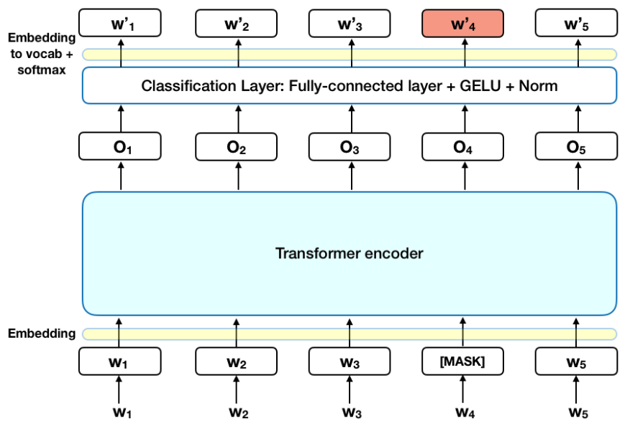
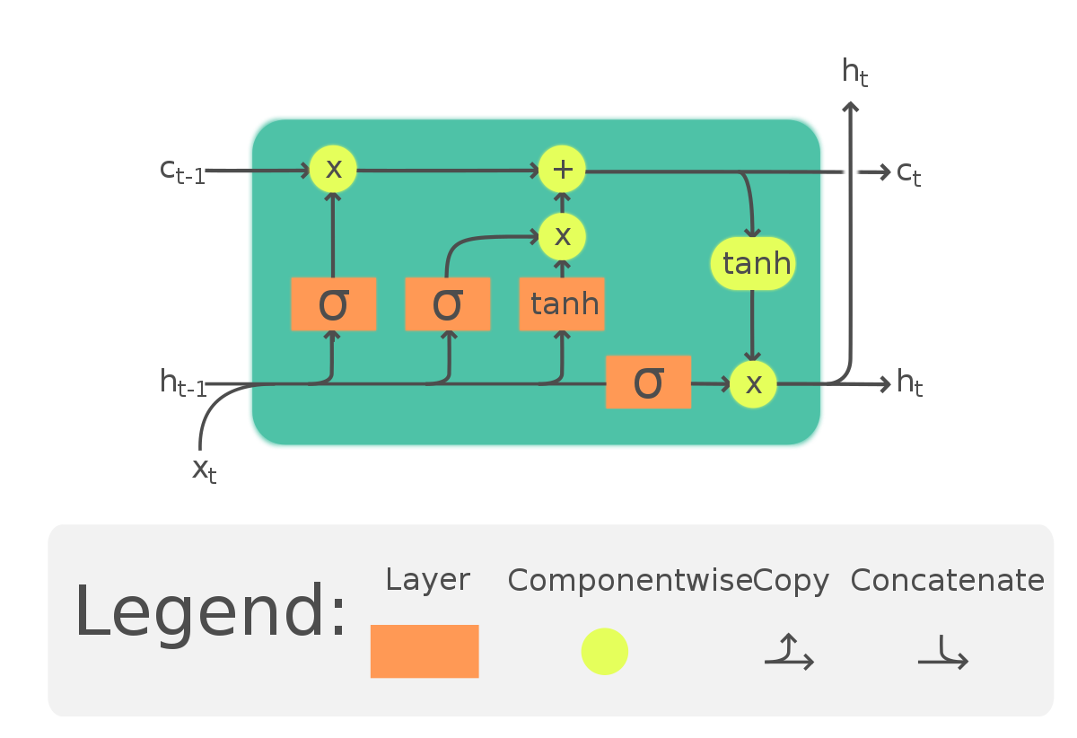
Algorithm used
BERT
Google’s robust NLP algorithm
Bidirectional (B)
Encoder Representations (ER)
Transformer (T)
LSTM
A type of RNN
The capability of learning long-term dependencies, especially in sequence prediction problems
Notes:
BERT (Bidirectional Encoder Representations from Transformers) is a recent paper published by researchers at Google AI Language. It has caused a stir in the Machine Learning community by presenting state-of-the-art results in a wide variety of NLP tasks, including Question Answering (SQuAD v1.1), Natural Language Inference (MNLI), and others.
BERT’s key technical innovation is applying the bidirectional training of Transformer, a popular attention model, to language modelling. This is in contrast to previous efforts which looked at a text sequence either from left to right or combined left-to-right and right-to-left training. The paper’s results show that a language model which is bidirectionally trained can have a deeper sense of language context and flow than single-direction language models.

Slide 10
Data set and preparation
The dataset includes 10-year data from 1/10/2012 to 1/10/2022.
The target variable is the close price on the next day.
The historical data of S&P500 have been collected from Yahoo Finance.
The data contains information about the stock such as High, Low, Open, Close, Adjacent close and Volume. Only the day-wise closing price of the stock has been extracted.
The text data has been collected from news data from Reuters
One news data relevant to stock price is randomly chosen the previous day.
Training data is 80% and validation data is 20%

Slide 11
Evaluation Indicator
Root Mean Square Error (RMSE)
Mean Absolute Error (MAE)
Profit factor (on progress)
The gross profit divided by the gross loss (including commissions) for the entire trading period.

Slide 12
Results
 | RMSE | MAE
Only historical data | 0.01410 | 0.00982
Only news data | 0.01460 | 0.01150
Assembled model | On progress | on progress
Notes:
And this is the table of the results.

Slide 13
Modification needed (On progress)
Addition of results of the assembled model
Addition of evaluation indicator
Creating graphs of the data set and the results
Comparison with other learning models
Comparison with other stock prices

Slide 14
Thank you.

